Slide 1
Stryker Data Exploratory Analysis

Slide 2
Needed Information
Necessary additional data for value added analysis:
Documentation of all relevant events (Part replacement, etc.)
Need both nominal and pre-fault sets of sensor data learn how to predict failure
Explicit specifications of the vehicle variant, configuration, operation, etc.
Variants with different modifications, weights, and mission profiles cannot be assumed to have similar component decay profiles. All of this contextual information must be recorded for valuable analysis.
Explicit specification of the sensor design, behavior and installation
Context surrounding what sensor data is incredibly important to assist in identification of sensor fault.
Sensors will have specific idiosyncrasies that need to be enumerated for proper confidence of analysis.
Desired Additional Information for value added analysis:
Reliable sensor performance, confidence indicators from the experiment designers
Appears that more than 1/3 of measured data is unusable
Possible installation failure, contextual reasoning for enable/disable
Sensor “stale/malfunctioning/max” value of zero instead of arbitrary maximums
Arbitrary value reporting will significantly distort means, standard deviation and all other statistical measurements.
Rejection criteria is unknown due to some max values being in acceptable operational range.

Slide 3
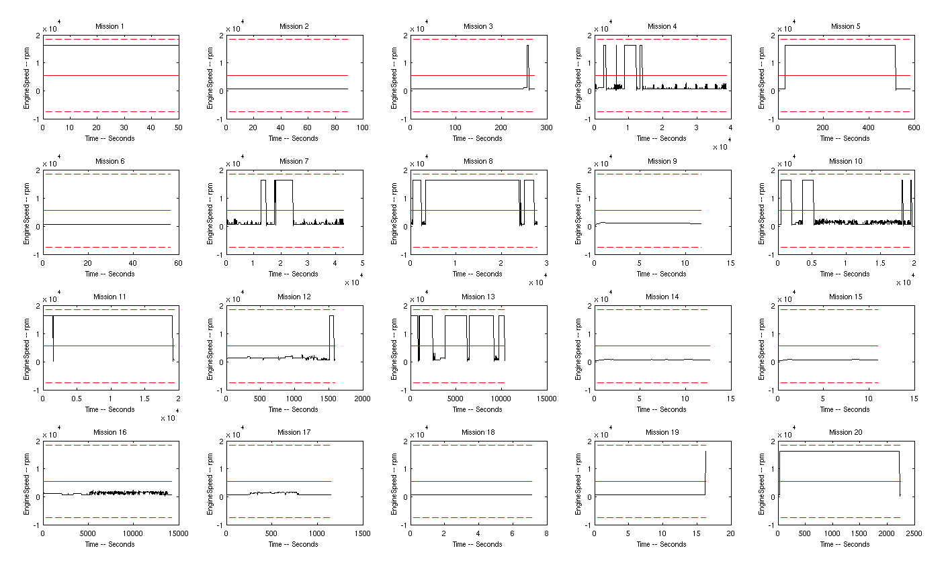
Quick Results

Slide 4
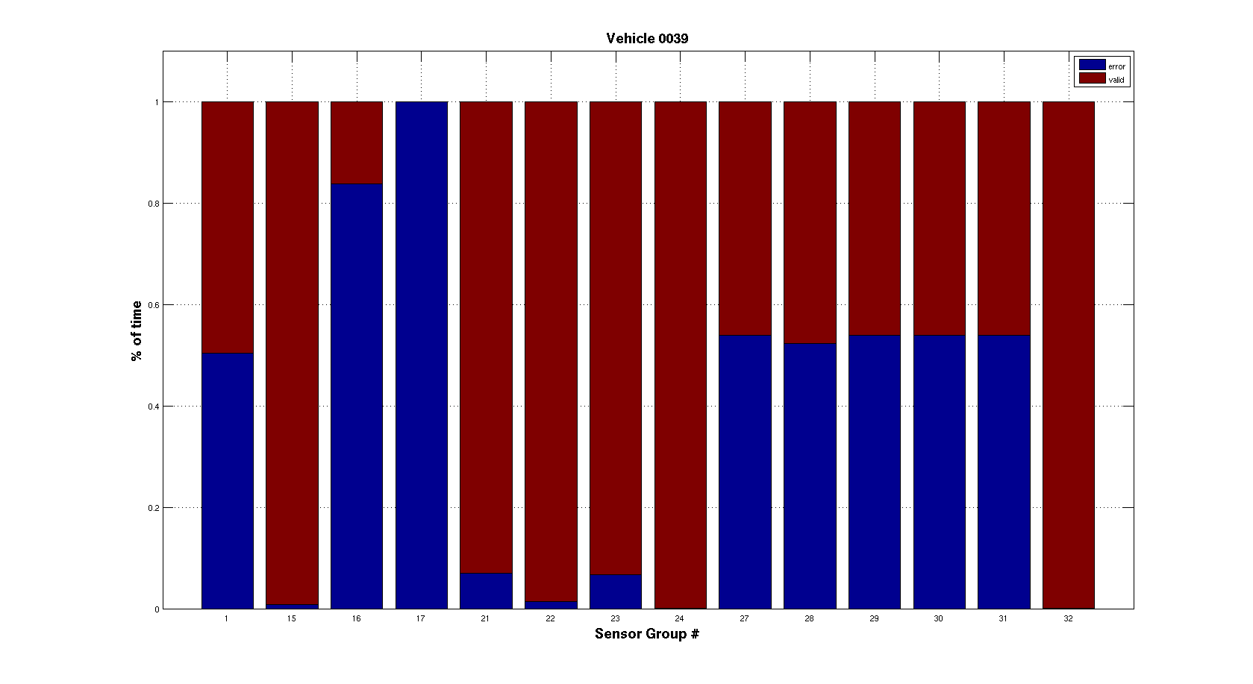
Quick Results

Slide 5
PHM Sensor Filter Design and Implementation

Slide 6
Analysis Tools & Rules
Noise Filtration
Kalman and Particle filter tested
Kalman Filter chosen due to only Gaussian noise being present, in which case a Klaman Filter is optimally conditioned as well as much cheaper computationally
Different state space models considered
Statistical Data Collection
Mean
Standard Deviation
Correlation Coefficient (R² value)
All data collected in both accumulating and periodic fashion
(Some) Analysis Rules
Sliding Averages over Intervals
R² correlation thresholds
N*standard deviation thresholds
Etc.

Slide 7
Pseudo-Code Outline
Data structure initializations
Data storage
Rule parameters
While time_i <= time_end
Initial/Interval Restart Kalman Filter Step
Interval FOR loop update sequence
Online Sensor Statistics and Fault Parameter Update
Fault Detection Rules
X (filtered sensor value) jump rules [define step function faults]
M (filtered sensor slope) jump rules [define steep ramp faults]
R Correlation threshold rules [define shallow ramp faults]
Fault Determination Decision Structure
Filter restart w/inferred fault parameters
Reinitialize filter at previous time steps to reanalyze data
End
End
End

Slide 8
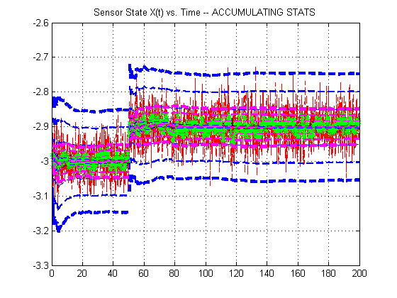
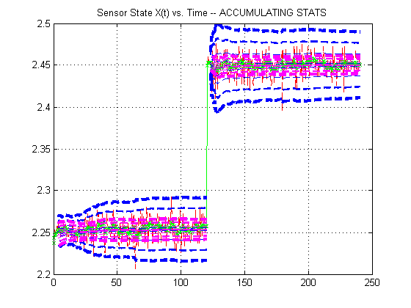
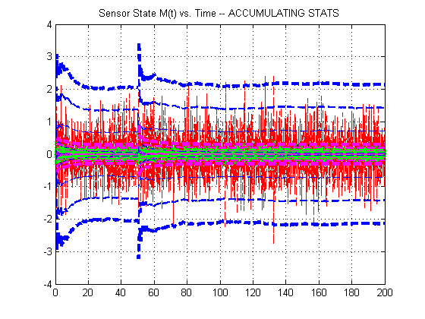
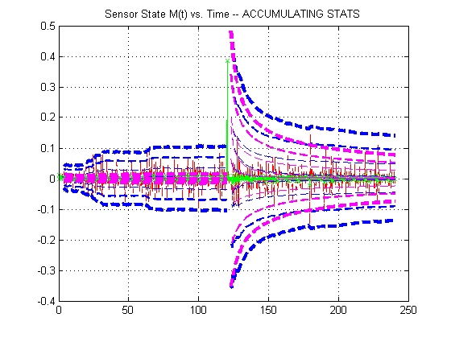
Example Simulations: Step
Worst Case Dataset
Sample PHM Dataset

Slide 9
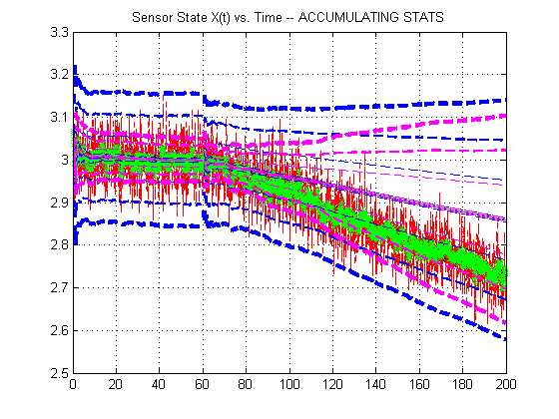
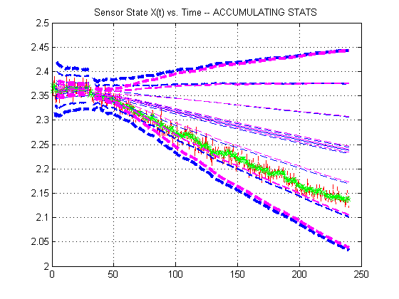
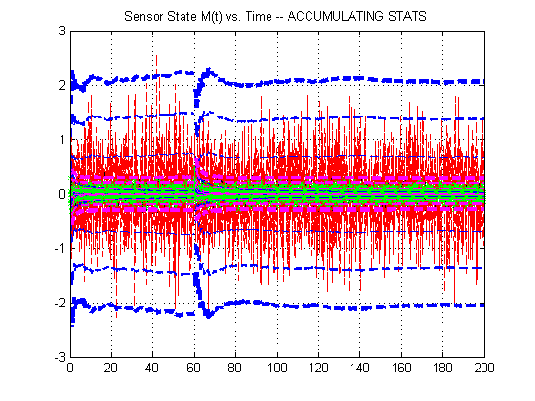
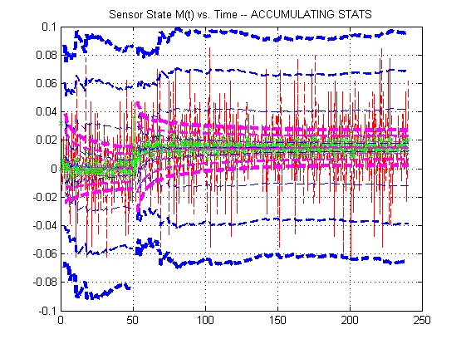
Example Simulations: Ramp
Worst Case Dataset
Sample PHM Dataset

Slide 10
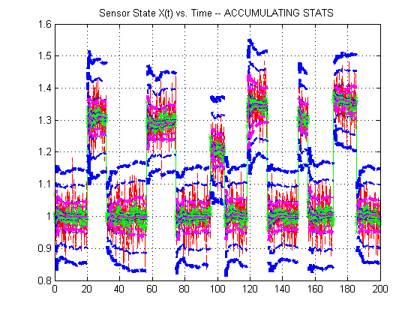
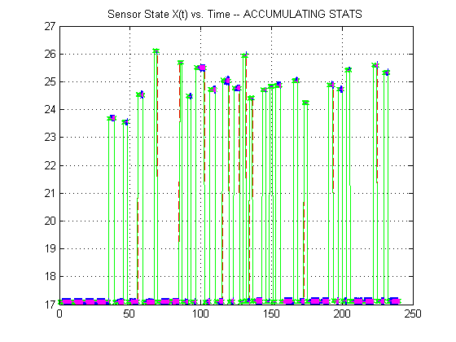
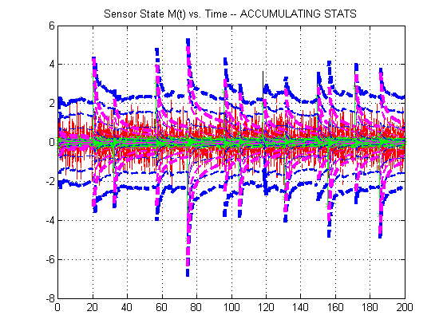
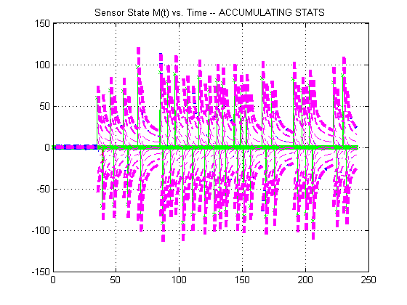
Example Simulations: Intermittent
Worst Case Dataset
Sample PHM Dataset

